Slide 1
Puppet

Slide 2
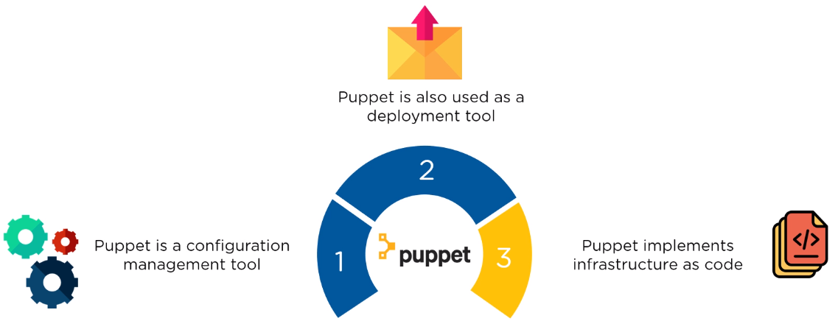
What is Puppet?

Slide 3
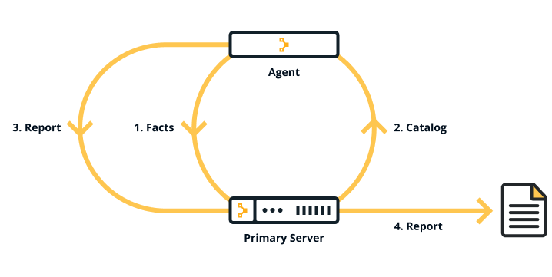
Puppet Architecture

Slide 4
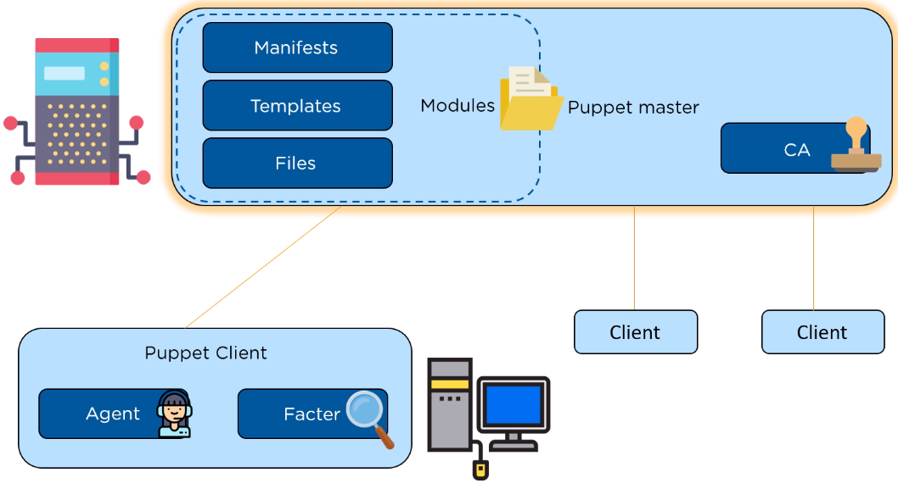
Puppet Architecture

Slide 5
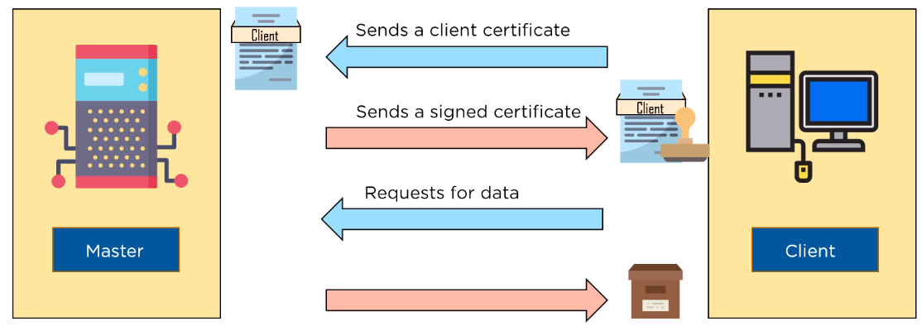
SSL Certification

Slide 6
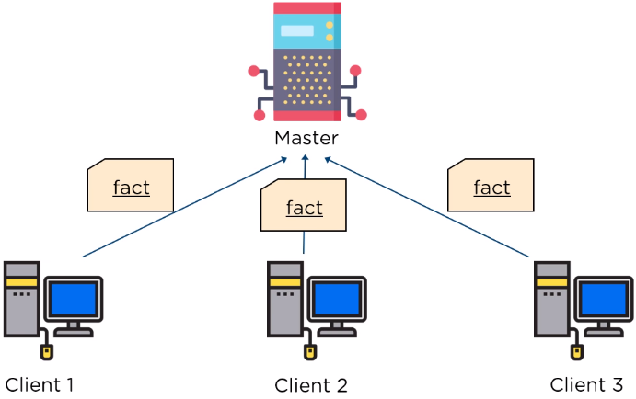
Factor sends state of the client to master

Slide 7
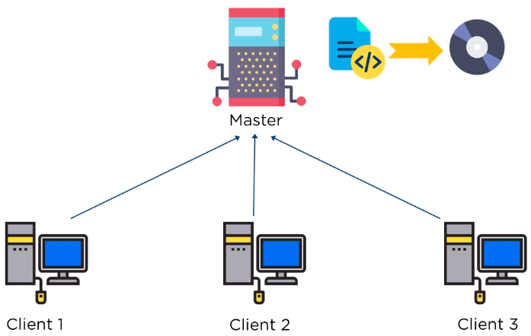
Based on facts master compiles manifests

Slide 8
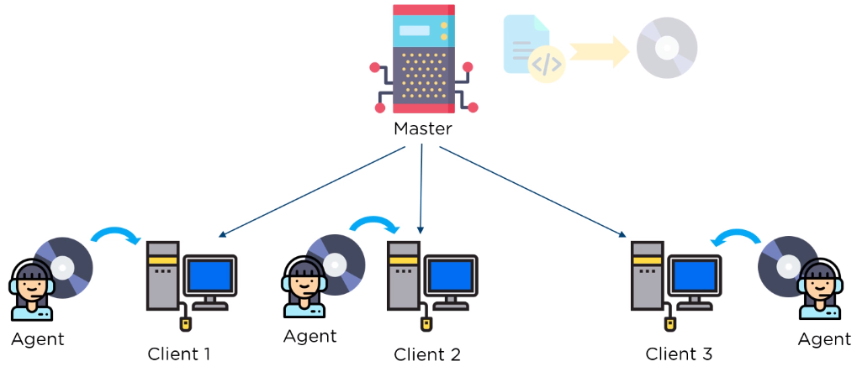
Agent on the client, executes the catalog

Slide 9
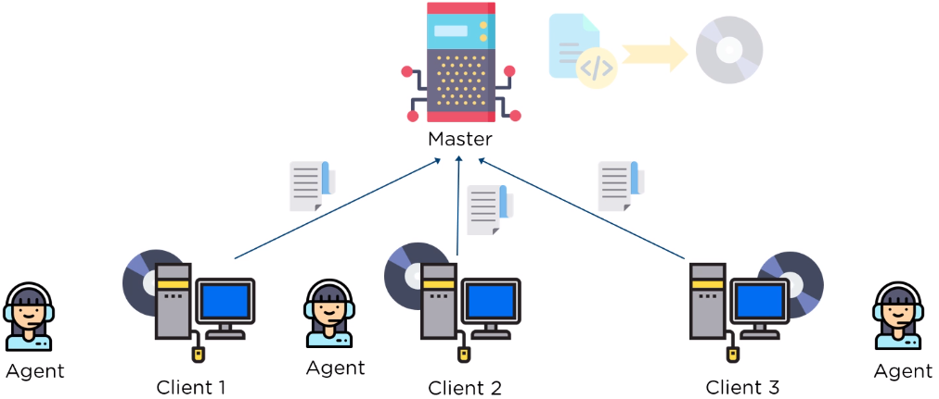
Report is sent back to the master

Slide 10
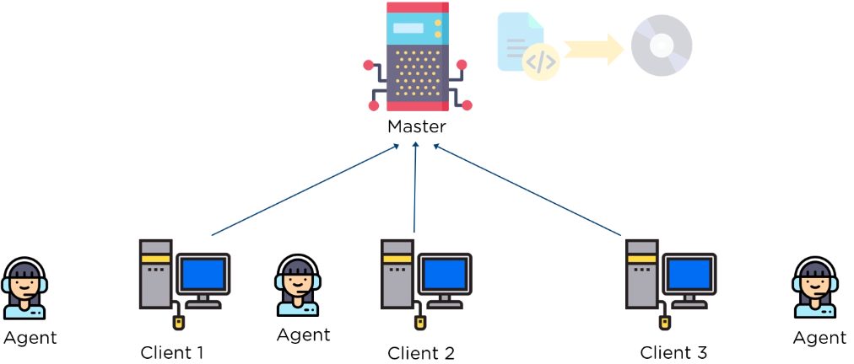
Report is generated and sent every 30 minutes

Slide 11
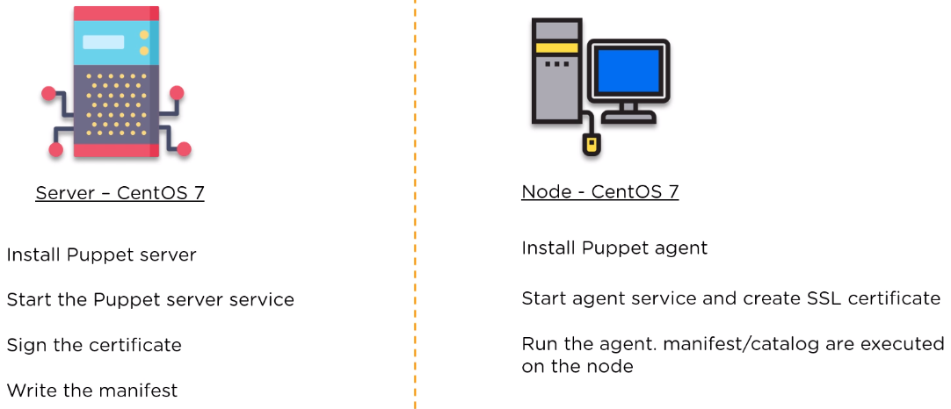
Puppet Setup

Slide 12
Hands-On
Refer: Puppet Setup and Hands On.txt

Slide 13
Why use Puppet desired state management?
Consistency
Troubleshooting problems with servers is a
time-consuming and
manually intensive process.
Without configuration management
Unable to make assumptions about infrastructure
Using Puppet, able to validate that Puppet applied the desired state you wanted.

Slide 14
Why use Puppet desired state management?
Automation
If you have
100 or 1,000 servers,
a mixed environment, or
you have plans to scale your infrastructure in the future,
It is difficult to do this manually
This is where Puppet can help you — to save you time and money, to scale effectively, and to do so securely.

Slide 15
Key concepts behind Puppet
Infrastructure-as-code
Idempotency
The ability to repeatedly apply code to guarantee a desired state on a system, with the assurance that you will get the same result every time.
Agile methodology
Working in incremental units of work and reusing code
Git and version control

Slide 16
The components that make up Puppet
Puppet Server and Puppet agent
Configured in an agent-server architecture
Includes a built-in certificate authority for managing certificates
Performs the role of the primary node and also runs an agent to configure itself.
Facter
Gathers facts about an agent node such as its hostname, IP address, and OS
Hiera
Separate data from the code and place it in a centralized location.
PuppetDB
All data generated (for example facts, catalogs, reports) is stored in PuppetDB

Slide 17
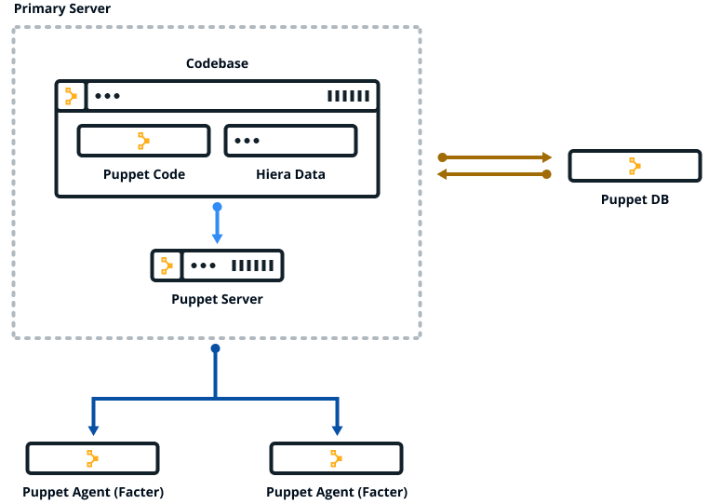

Slide 18
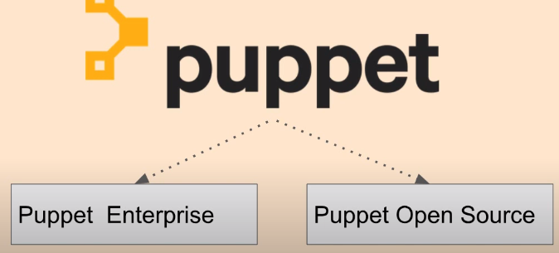

Slide 19
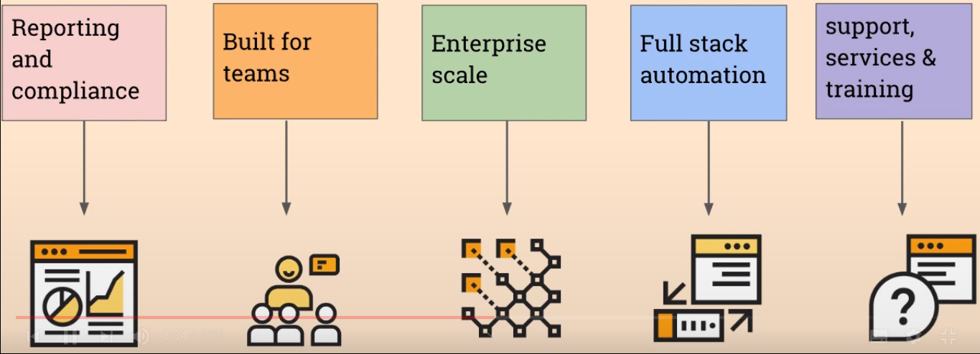
Why Puppet Enterprise

Slide 20
Thanks

